Slide 1
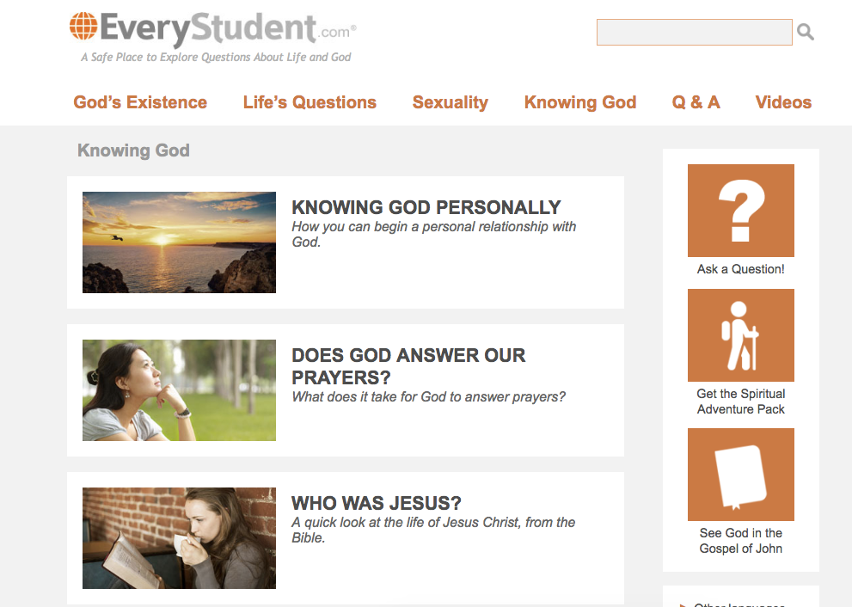

Slide 3
The Spiritual Adventure Pack
When I was an atheist, there was nothing more mysterious to me than this: "Having faith in God."
I wondered, how does a rational person even begin to believe in God?
Maybe you've wondered the same. I discovered a few compelling answers.
So I created a journey for us. It's a series of 7 emails, I'm calling, “The Spiritual Adventure Pack.”
It's completely free, and I'd like to invite you to sign up for it. I'm pretty sure you'll find it to be unique to anything you've seen before.

Slide 5
“Although you don’t know me I feel that you’ve taken my hand and led me on a very special journey these last few weeks. You have led me from complete denial of God’s existence to not just believing in Him but knowing that He is there. The evidence you give was sufficient to convince this 33 year old, life-long atheist; not an easy challenge!” ~ Caroline

Slide 6
“I just want to thank you from the bottom of my heart for this study series, it’s changed my life. It’s what I’ve been searching for and never found.” ~Nicki

Slide 7
“Thank you for the spiritual adventure pack, to say it has transformed my life would be an understatement. I grew up in a passionately atheist family… I realised that I had to let God into my life and couldn’t keep on living with philosophic scepticism... regardless of how my family would judge me.” ~ George

Slide 8
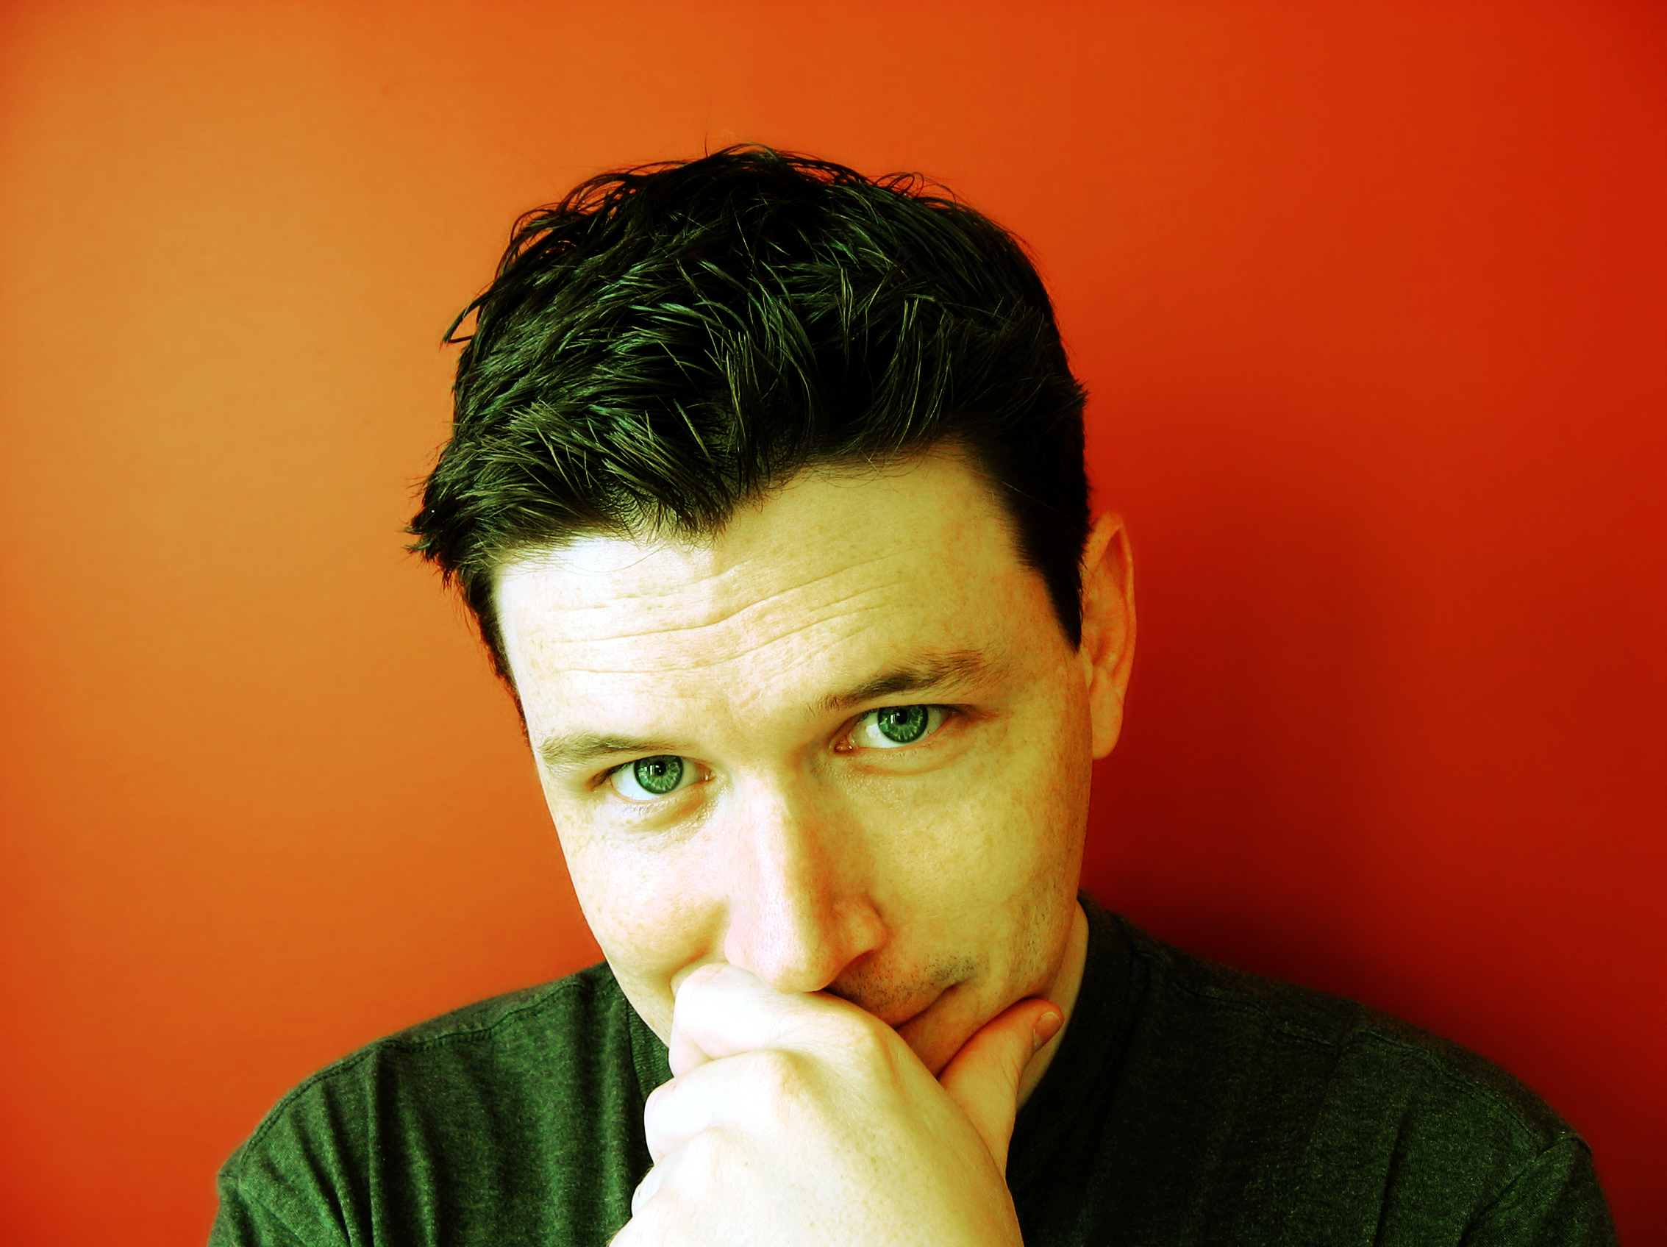

Slide 9
